Slide 1

Landmark Metropolitan University Institute
School of Engineering and Technology
WEBSITE TO CONNECT TAXIDRIVERS AND CUSTOMERS
GROUP 10:TECH TITANS
BABILA IVY-ROSE VANESSA WASE
BAH DIEUDONNE SIMBO NANAH
LACMAGO MAGNIAPI REBECCA
EFENZIA FUAFUELAKA ROMANUS
NNOLI TIMOTHY CHUKWUMEZIE
AMENDANG FLOURISH MOFOR
FONGANG VIOLET ENJECK
AWEDEMO TESITA KUMBO
STEPHEN NGULLE NJOH
AKERE EMILE NJI
VALENTINE NKAM ATANGA
DIBONKA FAITH
ESATENGANG FUAFUELAKA MOSCO

Slide 2
TRANSIT CAB
Transit Cab is a transportation company created in 2024 aiming at providing smooth and safe ride to clients from their pickup point to their required destination.
Transit cab is one of the finest taxi services in the region.
We are know for our professional approach and superior customer services at all times. We are dedicated to providing door-to-door online taxi services.
All our drivers and cars service providers associated with us are experts in the field and have immense knowledge of transit cab company.

Slide 3
Our objectives
We work with one goal in mind :
To provide a suitable ride and take our customers to their distinct destinations 24/7.

Slide 4
Methodology used
To come up with this project as a group, we decided to sub-divide the work as a whole into various tasks. By doing so it facilitated the designing of the website .
We used the iterative model for our project.
The tasks were being divided as follows;
Home page
Sign in page
Booking page
Registration Pages
Payment page
We use colors like;
Yellow
Black
White.
We did our research on;
How to create the various web pages.
How to style our work using css.
Also by watching tutorial videos .
Other taxi websites like zeo and yango
We held various meetings on how our tasks were improving.

Slide 5
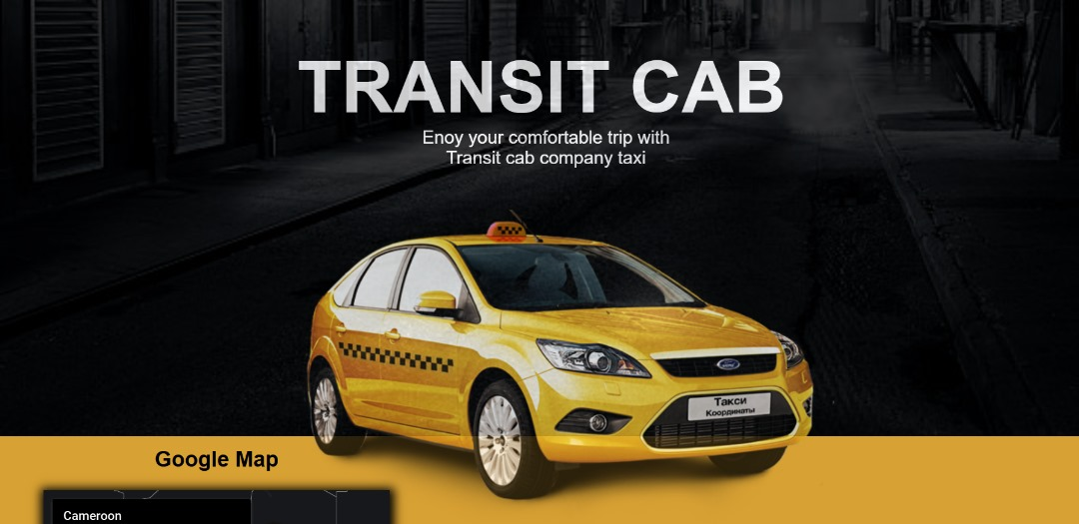
Home page

Slide 6
Difficulties and challenges
Below are some of the challenges that we faced individually and as a group;
To decide on the template to use.
We had a problem on dividing the tasks, so we solved it by doing Balloting.
We had issues on deciding and concluding on the numerous ideas each member had.
We had an issue with styling that is, using css.
We had an issue in combining the task.
We could not do the figma design at all .
We could not do the database of our project.

Slide 7
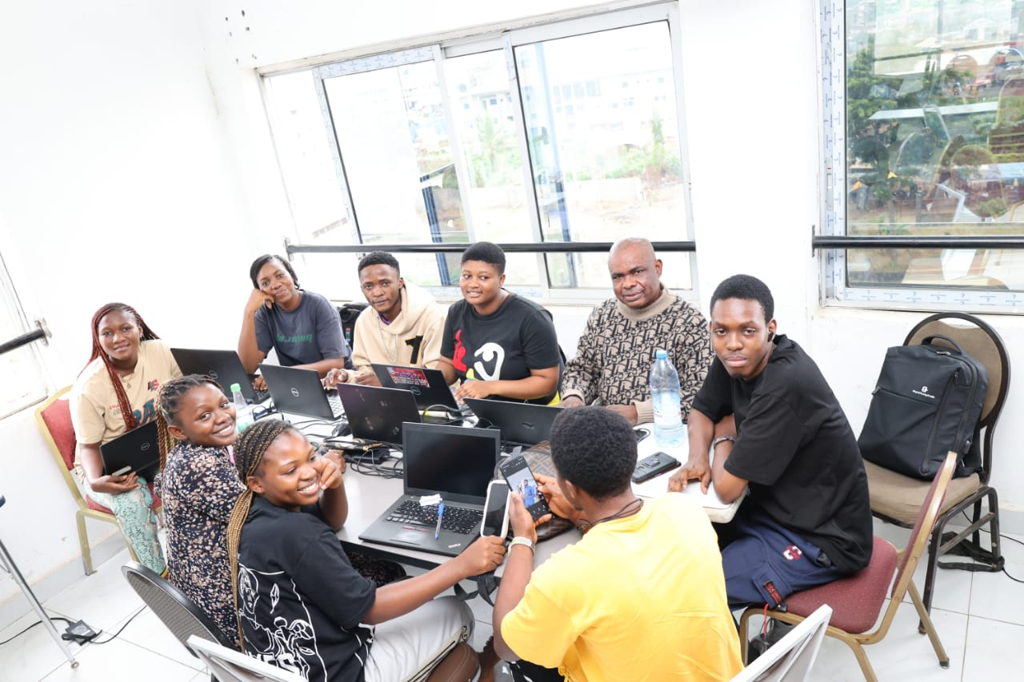
Conclusion
In a nutshell the transit cab has improved economical growth by reducing the number of people who suffer from moving from one place to another.
Despite the difficulties of the project the student were able to come out with this beautiful platform and we have learn a lot of things like how to link the pages ,create a home page , login page and registration page

